Slide 1
GSM and GPS based Vehicle tracking system

Slide 2
1. Introduction
Project Aim :
This project monitors the vehicle location using it’s longitude and latitude. We have designed a microcontroller based prototype model for the vehicle tracker.
For monitoring the location, we have used a SR86 GPS modem which responds to the changes in the location.
We have also used GSM modem to send the location tracking SMS.
The heart of the project i.e. the microcontroller is AT89s51.
The display used 16×2 line Liquid Crystal Display.
MAX232 has been used for the interfacing between microcontroller and GPS & GSM modem. With the help of this IC we can send the data to the GPS and GSM modem also.
The power module consists of IC7805 for 5V supply.

Slide 3
Block Diagram
Micro-controller
GPS modem
LCD Display
MAX232 interface
GSM modem

Slide 4
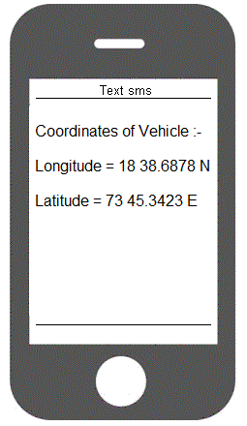
Text SMS on Mobile

Slide 5
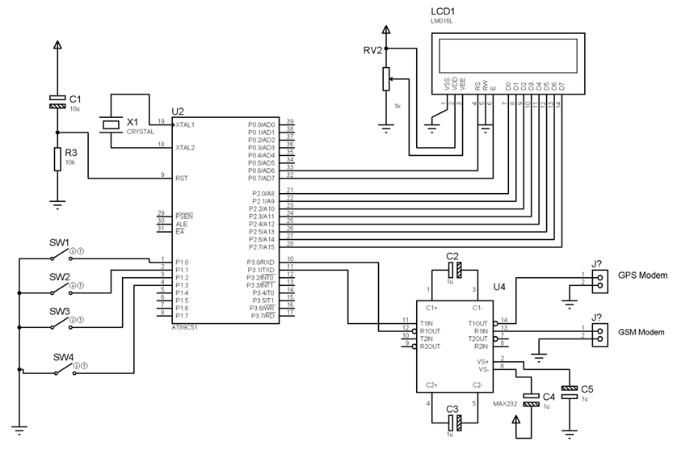
CIRCUIT DIAGRAM

Slide 6
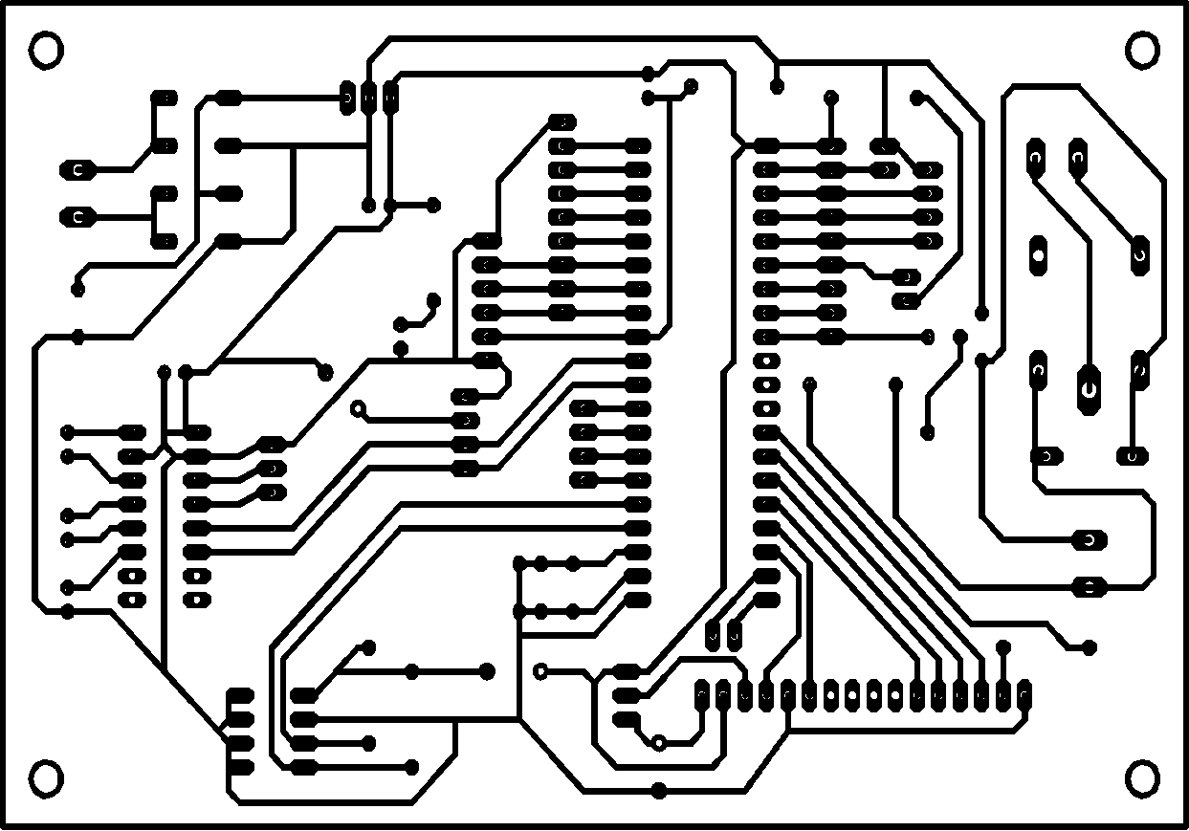
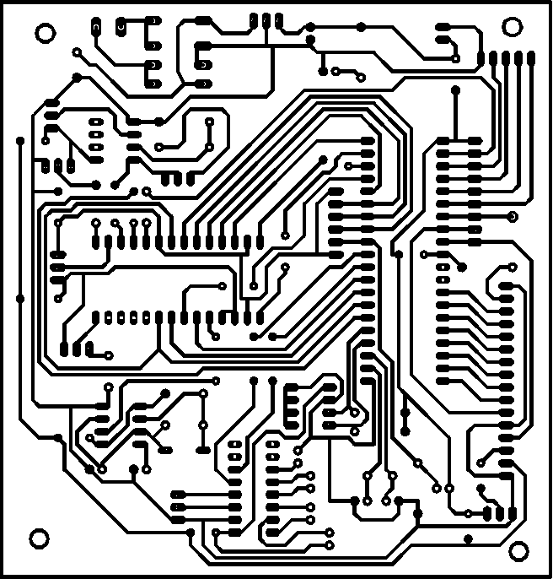
PCB LAYOUT

Slide 7
Software used in our Project
EAGLE Software: It is used for PCB design, it includes Schematic Capture, Board Layout and Autorouter.
EAGLE has following 2 sections:
1) Schematic capture: For designing circuit diagrams. Parts can be placed on many sheets and connected together through ports.
2) PCB layout: It allows auto-routing to automatically connect traces based on the connections defined in the schematic.
KEIL software: It used for Microcontroller Programming Software. It has compiler designed specifically for the 8051 microcontroller. It converts a High Level Language source code (written in assembly language or C language) into its object code. Then a linker is used to create an absolute object module suitable for your circuit.

Slide 8
Component List
AT89s51 MAX232 7805 7812 BC547 TRANSFORMER CAPACITOR DIODES(1N4007) RESISTORS | LCD Display CRYSTAL LED RELAY POT LCD CONNECTOR IC SOCKETS CONNECTORS GSM Modem GPS modem Metal plates

Slide 9
Applications
Applications and Advantages:
This project can be used to track the school bus.
This project can be used for cab or car of companies.
This can be used to track our car or any other vehicle
This project can also be used to track the ambulance of the hospital

Slide 10
Thank you

